Slide 2
Heading here
Body text here
Bullet text here

Slide 4
Heading here
Body text here
Bullet text here

Slide 5
Heading here
Body text here
Bullet text here

Slide 6
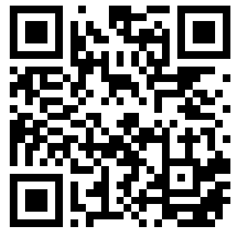
Scan here to donate
Notes:
Scan the QR code if you are interested in Online Giving on toysntucker.org.au

Slide 7
Heading here
Body text here
Bullet text here

Slide 8
Heading here
Body text here
Bullet text here

Slide 9
Heading here
Body text here
Bullet text here

Slide 10
Heading here
Body text here
Bullet text here

Slide 11
Heading here
Body text here
Bullet text here

Slide 12
Heading here
Body text here
Bullet text here

Slide 13
Heading here
Body text here
Bullet text here

